Slide 1
SOFTWARE
and
OPERATING SYSTEM

Slide 2
WHAT IS IT ?????

Slide 3
LET’S REVISE
A computer consists of 2 components – hardware and software.
The physical components with which the computer communicates with the external environment is called hardware
(H/W).

Slide 4

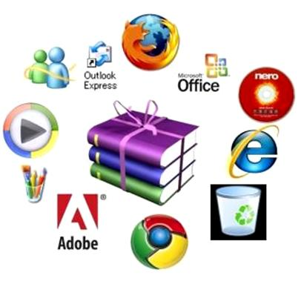
All the programs that run on the computer hardware are called software.
It is a collection of all programs that tell the computer what to do and how to do it.
.

Slide 5
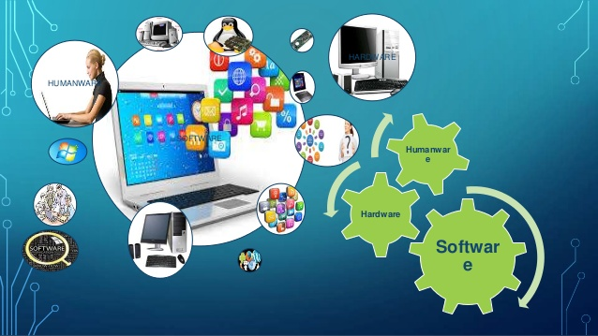
S/W is like the ‘soul’ which brings life to the hardware

Slide 6
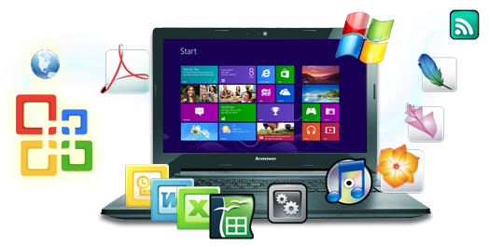
It is something which cannot be touched, but SENSED.
It is the interpreter between us and the computer.
SOFTWARE

Slide 7
software
system
application

Slide 8
System S/W is classified as:
1.)Language Translators
Assemblers
Compilers
Interpreters
2.) Operating System (O.S.)
3.) Utility Programs

Slide 9
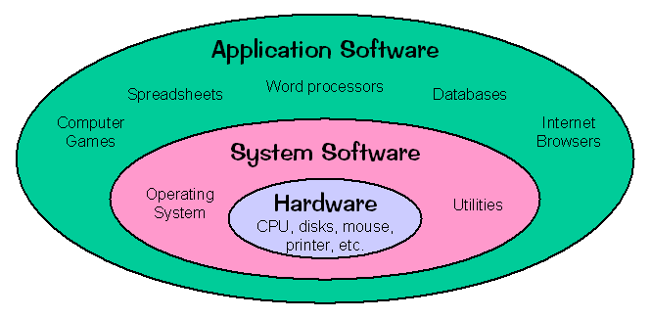

Slide 10
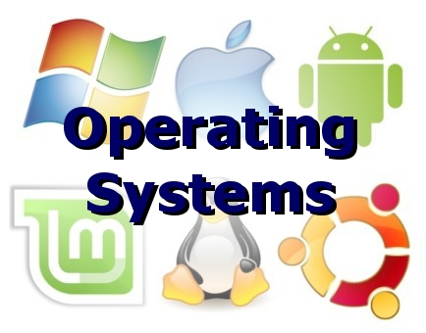

Slide 11
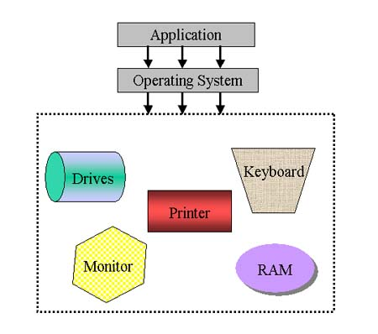
Your computer's operating system (O.S.) manages all of the software and hardware on the computer.

Slide 12
Most of the time, there are several different computer programs running at the same time, and they all need to access your computer's central processing unit (CPU), memory, and storage.
The operating system coordinates all of this to make sure each program gets what it needs.

Slide 13
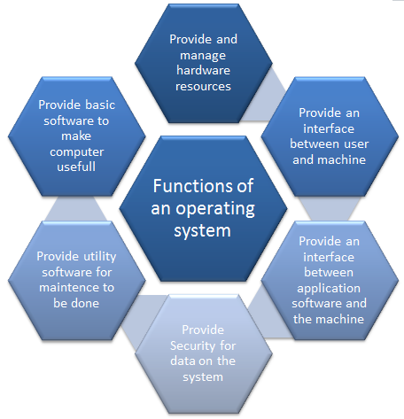

Slide 14
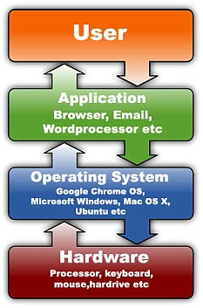
Provides the basic working environment for a computer user and application S/W.
It acts as an interface between the user and the H/W
It is required to start and shutdown the computer.
It helps in sharing resources also.
The user interacts with the system through the O.S.

Slide 15
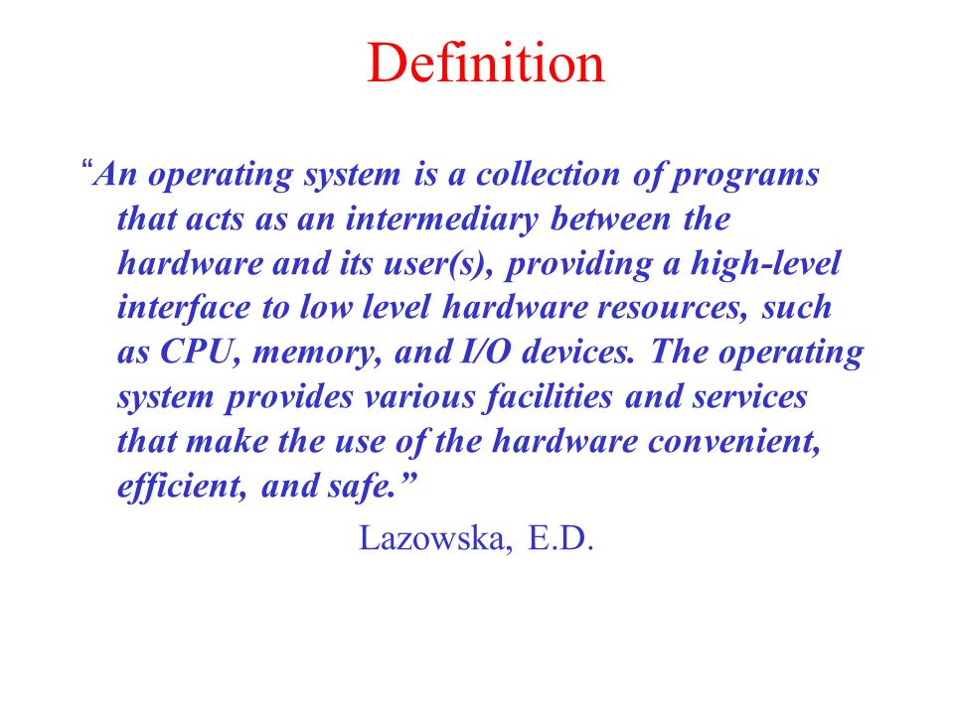

Slide 16
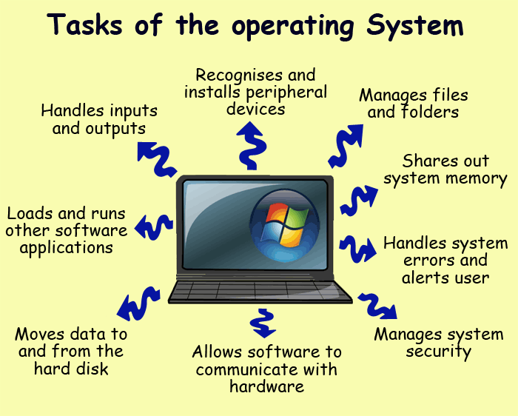

Slide 17
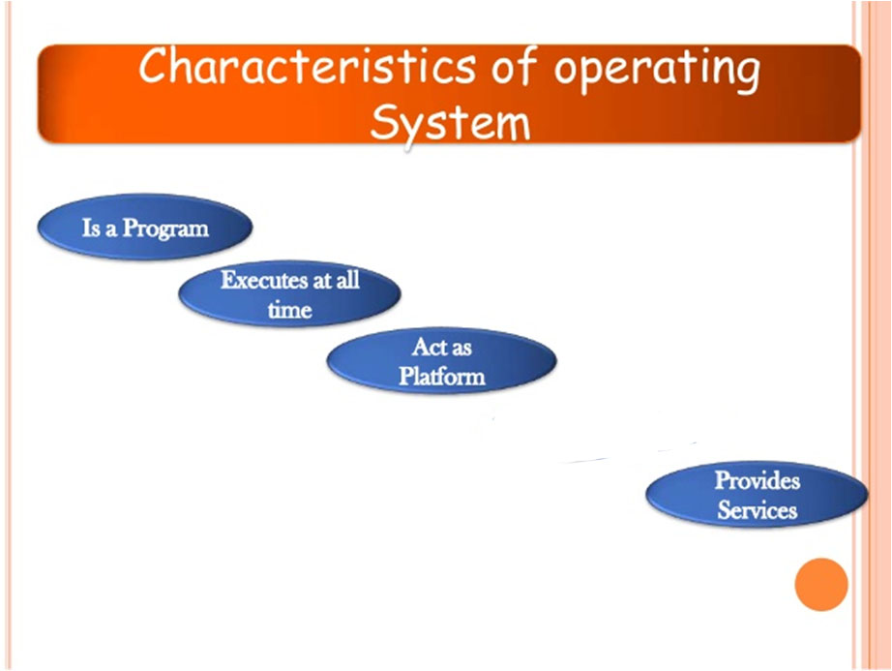

Slide 18
The OS is classified as :
CUI – here the user interacts with the O.S by typing the commands
GUI – the look of the Operating System is graphic oriented. The user uses a host of devices like the mouse to interact with the O.S.

Slide 19

How does an Operating System load itself?

Slide 20
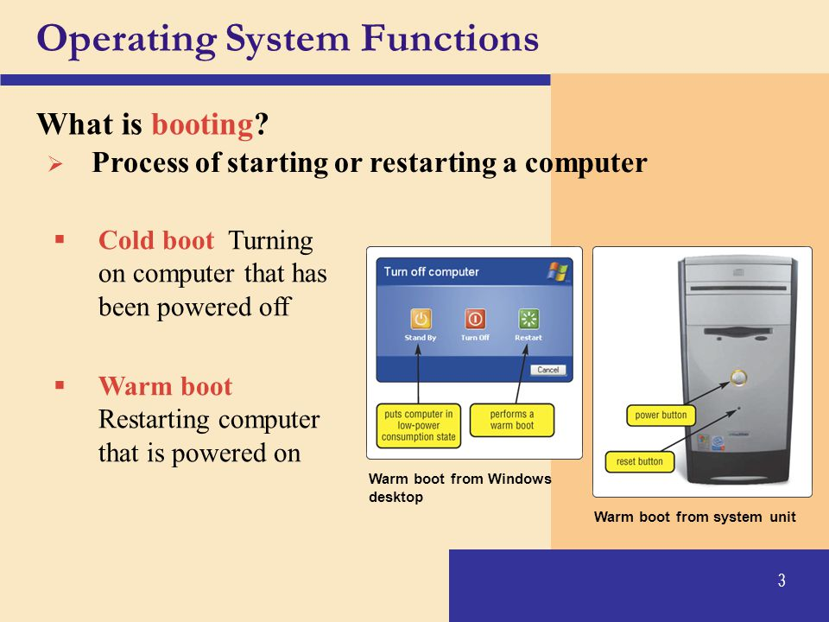

Slide 21
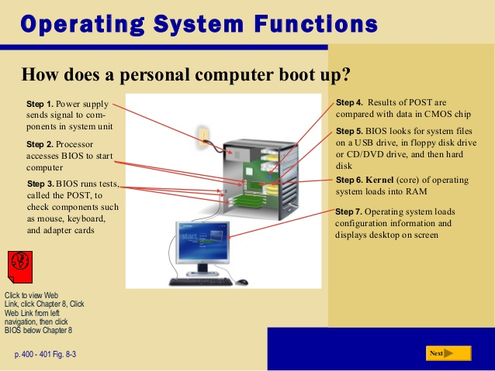

Slide 22
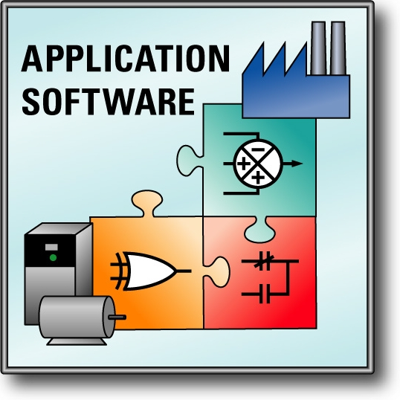
APPLICATION S/W
It is a set of programs which are put together for a specific purpose or task.

Slide 23

General Purpose
Customised

Slide 24
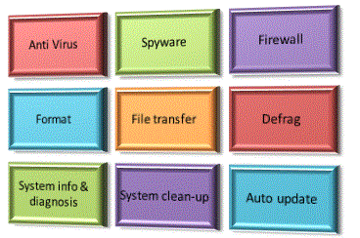
UTILITY S/W
is designed to perform maintenance or housekeeping work on a computer system in order to ensure its smooth functioning.

Slide 25
Disk Defragmentation
Disk Backup
Disk Clean up
Anti Virus

Slide 26
Made with the help images from Google.

